Slide 1

2023届汕头二模
读 后 续 写
“歌美人更美-
帮助小女孩等爸爸”

Slide 2
01
原文分析
contents
02
表达积累
03
续写扩展
04
续写赏析

Slide 3
It was a rather crowded day at the subway station. Seeing the busy passers-by stopped by his performance, Eric, a music lover who just graduated from college, wore a big smile on his face.
With deep passion for music, he showed up in the station in his spare time, singing and playing the guitar to people travelling to and from the subway station.
With the melodious (悦耳的)song coming to an end, hearty applause burst out. As usual, Eric expressed his gratitude, nodding his head with a smile. “ Man, awesome! An outstanding performance!” Approached a man, holding the hand of a little girl in a ponytail(马尾辫)，aged about four.
“Park, a producer of a record company.”The man introduced himself, holding out his hand."Would you like to give it a try in my company?” Out of politeness, Eric shook hands with him in amazement.
“I haven't seen somebody this good in a long time! You are a beautiful scenery of this city with such a beautiful voice!”Park admired. Suddenly, a phone call interrupted their conversation. Park briefly invited Eric to meet later in the same place and walked away to answer the call. Seeing Park off, Eric did realize what had happened, with warm current flowing from his head to toes.It was the first time that he had earned such kind of recognition, which was totally out of his expectation.
“A beautiful scenery of the city, with a beautiful voice! ” Eric repeated the words, cleaning his guitar and preparing for the next performance. At that time, he caught sight of a little girl in a ponytail standing in a corner, weeping and looking around. Carrying his guitar, Eric approached her and squatted(蹲) down, “What’s wrong with you, honey? ”
Para 1："I can't find my daddy.” The girl burst out crying.
Para2: The girl calmed down in Eric's song when a man rushed into the office of the subway. station.
Notes:
更多模板亮亮图文旗舰店：https://liangliangtuwen.tmall.com

Slide 4

01
原文分析

Slide 5
It was a rather crowded day at the subway station. Seeing the busy passers-by stopped by his performance, Eric, a music lover who just graduated from college, wore a big smile on his face.
With deep passion for music, he showed up in the station in his spare time, singing and playing the guitar to people travelling to and from the subway station.
With the melodious (悦耳的)song coming to an end, hearty applause burst out. As usual, Eric expressed his gratitude, nodding his head with a smile. “ Man, awesome! An outstanding performance!” Approached a mnan, holding the hand of a little girl in a ponytail(马尾辫)，aged about four.
“Park, a producer of a record company.”The man introduced himself, holding out his hand."Would you like to give it a try in my company?” Out of politeness, Eric shook hands with him in amazement.
“I haven't seen somebody this good in a long time! You are a beautiful scenery of this city with such a beautiful voice!”Park admired. Suddenly, a phone call interrupted their conversation. Park briefly invited Eric to meet later in the same place and walked away to answer the call. Seeing Park off, Eric did realize what had happened, with warm current flowing from his head to toes.It was the first time that he had eamed such kind of recognition, which was totally out of his expectation.
“A beautiful scenery of the city, with a beautiful voice! ” Eric repeated the words, cleaning his guitar and preparing for the next performance. At that time, he caught sight of a little girl in a ponytail standing in a corner, weeping and looking around. Carrying his guitar, Eric approached her and squatted(蹲) down, “What’s wrong with you, honey? ”
Para 1："I can't find my daddy.” The girl burst out crying.
Para2: The girl calmed down in Eric's song when a man rushed into the office of the subway station.
如何快速梳理故事情节线与情感线？
Tip 1:找时间线索，时间的变化带来情节的发展
Tip 2:找地点线索,地点的变化带来情节的发展
Tip 3:找逻辑关系词, 逻辑的变化带来情节的发展
Notes:
更多模板亮亮图文旗舰店：https://liangliangtuwen.tmall.com

Slide 6
Read for plots
Eric put on performance at the subway station.
It was a rather crowded day at the subway station. Seeing the busy passers-by stopped by his performance, Eric, a music lover who just graduated from college, wore a big smile on his face.
With deep passion for music, he showed up in the station in his spare time, singing and playing the guitar to people travelling to and from the subway station.
With the melodious (悦耳的)song coming to an end, hearty applause burst out. As usual, Eric expressed his gratitude, nodding his head with a smile. “ Man, awesome! An outstanding performance!” Approached a man, holding the hand of a little girl in a ponytail(马尾辫)，aged about four.
“Park, a producer of a record company.”The man introduced himself, holding out his hand.” Would you like to give it a try in my company?” Out of politeness, Eric shook hands with him in amazement.
“I haven't seen somebody this good in a long time! You are a beautiful scenery of this city with such a beautiful voice!”Park admired. Suddenly, a phone call interrupted their conversation. Park briefly invited Eric to meet later in the same place and walked away to answer the call. Seeing Park off, Eric did realize what had happened, with warm current flowing from his head to toes.It was the first time that he had eamed such kind of recognition, which was totally out of his expectation.
“A beautiful scenery of the city, with a beautiful voice! ” Eric repeated the words, cleaning his guitar and preparing for the next performance. At that time, he caught sight of a little girl in a ponytail standing in a corner, weeping and looking around. Carrying his guitar, Eric approached her and squatted(蹲) down, “What’s wrong with you, honey? ”
Para 1："I can't find my daddy.” The girl burst out crying.
Para2: The girl calmed down in Eric's song when a man rushed into the office of the subway station.
happy, satisfied
Park spoke highly of Eric’s performance and invited him to work in his company.
amazed
Park left to answer a call, only to leave the girl alone .
concerned
Notes:
更多模板亮亮图文旗舰店：https://liangliangtuwen.tmall.com

Slide 7

Analyze the Plot and Emotion
Climax
Park left to answer a call, only to leave the girl alone .
Para 1："I can't find my daddy.” The girl burst out crying.
Rising action
Falling action
Park spoke highly of Eric’s performance and invited him to work in his company.
Para2: The girl calmed down in Eric's song when a man rushed into the office of the subway station.
Background
Ending
Eric put on performance at the subway station.
???

Slide 8
Read for Characters
It was a rather crowded day at the subway station. Seeing the busy passers-by stopped by his performance, Eric, a music lover who just graduated from college, wore a big smile on his face.
With deep passion for music, he showed up in the station in his spare time, singing and playing the guitar to people travelling to and from the subway station.
With the melodious (悦耳的)song coming to an end, hearty applause burst out. As usual, Eric expressed his gratitude, nodding his head with a smile. “ Man, awesome! An outstanding performance!” Approached a man, holding the hand of a little girl in a ponytail(马尾辫)，aged about four.
“Park, a producer of a record company.”The man introduced himself, holding out his hand.” Would you like to give it a try in my company?” Out of politeness, Eric shook hands with him in amazement.
“I haven’t seen somebody this good in a long time! You are a beautiful scenery of this city with such a beautiful voice!”Park admired. Suddenly, a phone call interrupted their conversation. Park briefly invited Eric to meet later in the same place and walked away to answer the call. Seeing Park off, Eric did realize what had happened, with warm current flowing from his head to toes.It was the first time that he had earned such kind of recognition, which was totally out of his expectation.
“A beautiful scenery of the city, with a beautiful voice! ” Eric repeated the words, cleaning his guitar and preparing for the next performance. At that time, he caught sight of a little girl in a ponytail standing in a corner, weeping and looking around. Carrying his guitar, Eric approached her and squatted(蹲) down, “What’s wrong with you, honey? ”
Para 1："I can't find my daddy.” The girl burst out crying.
Para2: The girl calmed down in Eric's song when a man rushed into the office of the subway station.
music-loving,
polite;
Warm-hearted
Eric:
Park:
clear-eyed(有眼光的)，careless
Notes:
更多模板亮亮图文旗舰店：https://liangliangtuwen.tmall.com

Slide 9
Read for conflicts
It was a rather crowded day at the subway station. Seeing the busy passers-by stopped by his performance, Eric, a music lover who just graduated from college, wore a big smile on his face.
With deep passion for music, he showed up in the station in his spare time, singing and playing the guitar to people travelling to and from the subway station.
With the melodious (悦耳的)song coming to an end, hearty applause burst out. As usual, Eric expressed his gratitude, nodding his head with a smile. “ Man, awesome! An outstanding performance!” Approached a man, holding the hand of a little girl in a ponytail(马尾辫)，aged about four.
“Park, a producer of a record company.”The man introduced himself, holding out his hand.” Would you like to give it a try in my company?” Out of politeness, Eric shook hands with him in amazement.
“I haven’t seen somebody this good in a long time! You are a beautiful scenery of this city with such a beautiful voice!”Park admired. Suddenly, a phone call interrupted their conversation. Park briefly invited Eric to meet later in the same place and walked away to answer the call. Seeing Park off, Eric did realize what had happened, with warm current flowing from his head to toes.It was the first time that he had earned such kind of recognition, which was totally out of his expectation.
“A beautiful scenery of the city, with a beautiful voice! ” Eric repeated the words, cleaning his guitar and preparing for the next performance. At that time, he caught sight of a little girl in a ponytail standing in a corner, weeping and looking around. Carrying his guitar, Eric approached her and squatted(蹲) down, “What’s wrong with you, honey? ”
Para 1："I can't find my daddy.” The girl burst out crying.
Para2: The girl calmed down in Eric's song when a man rushed into the office of the subway station.
1. The lost girl need Eric’s help to find her Dad, but Park asked him to meet later in the same place.
Notes:
更多模板亮亮图文旗舰店：https://liangliangtuwen.tmall.com

Slide 10
Read for hints
It was a rather crowded day at the subway station. Seeing the busy passers-by stopped by his performance, Eric, a music lover who just graduated from college, wore a big smile on his face.
With deep passion for music, he showed up in the station in his spare time, singing and playing the guitar to people travelling to and from the subway station.
With the melodious (悦耳的)song coming to an end, hearty applause burst out. As usual, Eric expressed his gratitude, nodding his head with a smile. “ Man, awesome! An outstanding performance!” Approached a man, holding the hand of a little girl in a ponytail(马尾辫)，aged about four.
“Park, a producer of a record company.”The man introduced himself, holding out his hand.” Would you like to give it a try in my company?” Out of politeness, Eric shook hands with him in amazement.
“I haven’t seen somebody this good in a long time! You are a beautiful scenery of this city with such a beautiful voice!”Park admired. Suddenly, a phone call interrupted their conversation. Park briefly invited Eric to meet later in the same place and walked away to answer the call. Seeing Park off, Eric did realize what had happened, with warm current flowing from his head to toes.It was the first time that he had earned such kind of recognition, which was totally out of his expectation.
“A beautiful scenery of the city, with a beautiful voice! ” Eric repeated the words, cleaning his guitar and preparing for the next performance. At that time, he caught sight of a little girl in a ponytail standing in a corner, weeping and looking around. Carrying his guitar, Eric approached her and squatted(蹲) down, “What’s wrong with you, honey? ”
Para 1："I can't find my daddy.” The girl burst out crying.
Para2: The girl calmed down in Eric's song when a man rushed into the office of the subway station.
1.a man with a little girl in a ponytail,为下文my daddy埋下伏笔
2. Eric不仅仅有美妙的歌声，还有美妙的心灵。
Notes:
更多模板亮亮图文旗舰店：https://liangliangtuwen.tmall.com

Slide 11

原文分析
Themes
原文分析
故事概要：Eric 热爱音乐，在地铁站为乘客弹唱表演，获得大家的赞赏，成为城市一道亮丽的风景，同时也得到一位唱片公司制作人 Park 的认可与邀约，然而 Park 因为接听电话而走开。不久，Eric 发现了一个在角落里哭泣的小女孩，他上前询问……
故事的主题：Eric 有美妙的歌喉，更有美好的心灵。友善

Slide 12
Analyze language
It was a rather crowded day at the subway station. Seeing the busy passers-by stopped by his performance, Eric, a music lover who just graduated from college, wore a big smile on his face.
With deep passion for music, he showed up in the station in his spare time, singing and playing the guitar to people travelling to and from the subway station.
With the melodious (悦耳的)song coming to an end, hearty applause burst out. As usual, Eric expressed his gratitude, nodding his head with a smile. “ Man, awesome! An outstanding performance!” Approached a man, holding the hand of a little girl in a ponytail(马尾辫)，aged about four.
“Park, a producer of a record company.”The man introduced himself, holding out his hand.” Would you like to give it a try in my company?” Out of politeness, Eric shook hands with him in amazement.
“I haven’t seen somebody this good in a long time! You are a beautiful scenery of this city with such a beautiful voice!”Park admired. Suddenly, a phone call interrupted their conversation. Park briefly invited Eric to meet later in the same place and walked away to answer the call. Seeing Park off, Eric did realize what had happened, with warm current flowing from his head to toes.It was the first time that he had earned such kind of recognition, which was totally out of his expectation.
“A beautiful scenery of the city, with a beautiful voice! ” Eric repeated the words, cleaning his guitar and preparing for the next performance. At that time, he caught sight of a little girl in a ponytail standing in a corner, weeping and looking around. Carrying his guitar, Eric approached her and squatted(蹲) down, “What’s wrong with you, honey? ”
Para 1："I can't find my daddy.” The girl burst out crying.
Para2: The girl calmed down in Eric's song when a man rushed into the office of the subway station.
1.丰富的动作描写
2. 适量的对话描写和情绪描写
根据语篇协同性原则：
续写部分应该有丰富的动作描写、适量的情绪和动作描写
Notes:
更多模板亮亮图文旗舰店：https://liangliangtuwen.tmall.com

Slide 13
03
续写扩展

Slide 14
Analyse the given sentences
What can you infer from the two sentences?
Para1: “I can’t find my daddy.” The girl burst out crying.
Para2: The girl calmed down in Eric's song when a man rushed into the office of the subway station.
Who is the girl? Who may be her daddy?
What was Eric’s reaction when he heard the words?
What did he do to comfort the girl? Is the process smooth?
How did Eric finally succeed to comfort the girl?
Who is the man?
Did the girl find her daddy?
What was the man and Eric’s reactions?
THEME

Slide 15
Paragraph 1
P1: “I can’t find my daddy.” The girl burst out crying.
Eric had no idea how to find the girl’s dad
Eric took the girl to the the office of the subway station.
Eric sang songs to comfort the girl.

Slide 16
Paragraph 2
P2: The girl calmed down in Eric's song when a man rushed into the office of the subway station.
Her daddy was Park. Finally, they united.
Park thanked Eric.
Eric not only has a beautiful voice, but also a beautiful soul.(THEME)

Slide 17
03
表达积累

Slide 18
形容音乐的形容词
1. melodious
2. rhythmic
3. soulful 深情的
4. expressive
5. harmonious
6. uplifting 振奋的
7. inspiring 鼓舞人心的
8. intense
9. dynamic
10. memorable 令人难忘的
11. joyful
12. relaxing
13. enchanting陶醉的

Slide 19
音乐安抚人心的各种表达
1.音乐有一种抚慰烦恼的灵魂的深刻能力。
Music has a profound ability to soothe the troubled soul.
2.音乐中平静的音符和节奏可以给身心带来平静。
The calming notes and rhythms of music can bring peace to the mind and body.
3. 听音乐可以在有压力或悲伤的时候提供安慰。
Listening to music can provide comfort during times of stress or sadness.
4. 音乐的旋律和和声可以把我们带到一个不同的时间或地点，让我们暂时摆脱麻烦。
The melodies and harmonies of music can transport us to a different time or place, allowing us to escape from our troubles for a while.

Slide 20
微情景写作：小女孩迷路惊慌失措的场景
小女孩漫无目的地在陌生的街道上徘徊，惊恐得睁大了眼睛。她的小手抓着她的泰迪熊，这是这种可怕情况下唯一的安慰。当她呼唤父母时，眼泪顺着脸颊流下来，但她声音的回声只会放大她的孤独感。她感到完全迷失了方向，一艘小船在广阔而充满敌对的大海上漂流。
The little girl wandered aimlessly through the unfamiliar streets, her eyes wide with terror. Her tiny hand clutched at her teddy bear, the only source of comfort in this frightening situation. Tears streamed down her cheeks as she called out for her parents, but the echoes of her voice only amplified her sense of isolation. She felt completely lost, a tiny ship adrift in a vast and hostile sea.

Slide 21
微情景写作：小女孩迷路后找到父亲的场景1
1.小女孩在拥挤的街道上漫无目的地闲逛，当她意识到自己迷路了时，她的心因恐惧而怦怦直跳。但就在她要哭出来的时候，她看见了远处她父亲熟悉的脸，便张开双臂向他跑去。
The little girl wandered aimlessly through the crowded streets, her heart pounding with fear as she realized she was lost. But just as she was about to break down in tears, she saw her father's familiar face in the distance, and ran towards him with open arms.

Slide 22
微情景写作：小女孩迷路后找到父亲的场景2
2.随着太阳开始落山，阴影越来越长，这个失去的小女孩也变得越来越焦虑了。但她突然听到一个熟悉的声音在喊她的名字，便转过身来，看到她的父亲伸出双臂向她跑来。
As the sun began to set and the shadows grew longer, the lost little girl grew more and more anxious. But suddenly she heard a familiar voice calling out her name, and turned to see her father running towards her, his arms outstretched.

Slide 23
微情景写作：小女孩迷路后找到父亲的场景3
3.小女孩跌跌撞撞地穿过拥挤的市场，她的眼泪模糊了她的父亲。但就在她以为自己永远迷路了的时候，一只强壮的手伸出手，把她拉进了温暖的怀抱——她知道自己终于安全了。
The little girl stumbled through the crowded marketplace, her tears blurring her vision as she searched desperately for her father. But just when she thought she was lost forever, a strong hand reached out and pulled her into a warm embrace - and she knew she was finally safe.

Slide 24
with+宾语+宾补在记叙文的使用
1. With a frown on her face, she stormed out of the room.
她皱着眉头，怒气冲冲地走出了房间。
2. He raised an eyebrow with a look of disbelief.
他扬起眉毛，露出难以置信的表情。
3.With a shrug of his shoulders, he walked away.
他耸耸肩，走开了。
4. With a heavy heart, she left the party early.
她心情沉重，提前离开了聚会。
5. With a burst of laughter, they all cheered together.
随着一阵笑声，他们一起欢呼起来。

Slide 25
现在分词作状语的动作描写
1. Sitting on the park bench, she watched the children playing.
她坐在公园的长椅上，看着孩子们玩耍。
2. Running in the rain, he felt free and alive.
在雨中奔跑，他感到自由而有活力。
3. Cooking dinner, he hummed a tune and tasted the sauce.
在做晚饭时，他哼了一首曲子，尝了尝酱汁。
4. Typing away on the computer, she finished the report before the deadline.她在电脑上打字，在截止日期前完成了报告。
5. Balancing on one leg, he stretched his arms towards the sky.
他单腿保持平衡，向天空伸出双臂。

Slide 26
安抚走失哭泣小女孩的场景
现在分词作状语的动作描写
善良的男人走到迷路的小女孩面前，安慰地拥抱了她。他轻轻地擦去了她的眼泪，耐心地听着她分享着她的恐惧。他带着温暖的微笑和安慰的话语，帮助她找到了回家的路。
The kind-hearted man walked up to the lost, crying little girl and offered a comforting embrace. With a gentle touch, he wiped away her tears and listened patiently as she shared her fears. With a warm smile and reassuring words, he helped her find her way back home.

Slide 27
04
续写赏析

Slide 28
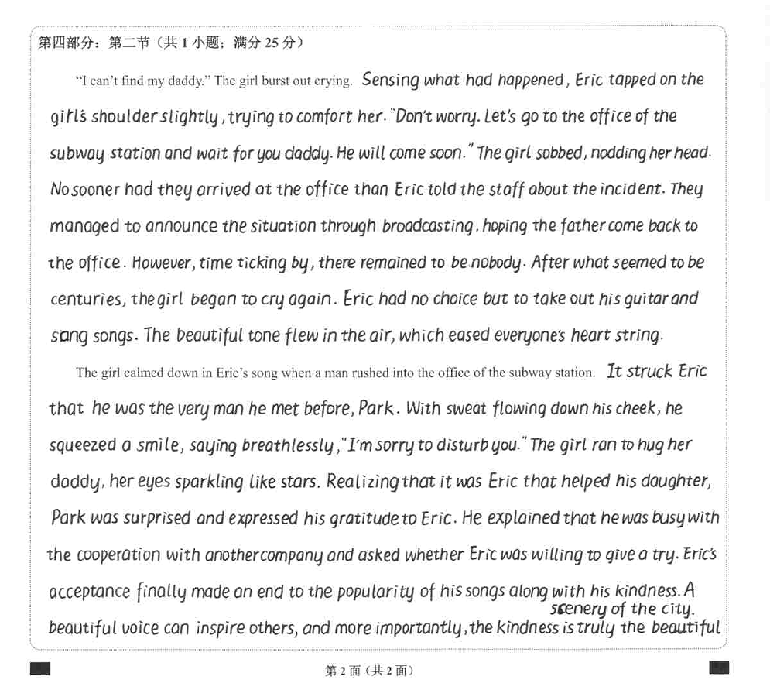
优秀学生习作
情节合理丰富，
衔接流畅自然,
语言丰富多样.

Slide 29
范文1
“I can't find my daddy." The girl burst out crying. Eric comforted her gently, but noticed the subway station office nearby. He realized he could use their loudspeaker to broadcast a message to help find her parents. But Eric also remembered his appointment with Park and wondered if he should go. Nevertheless, he took the girl's hand and led her to the office, seeking assistance. Looking at the tearful girl, Eric began to sing with his guitar, soothing her.
The girl calmed down in Eric's song when a man rushed into the office of the subway station. “Daddy!” the little girl joyfully recognized him as her father. To Eric's surprise, it was Park! “I thought that I may not have the chance to meet you again. ” said Eric, with a shy smile. “Glad to see you again. Thank you so much!” Park expressed his deep gratitude. “Daddy, Eric sings beautiful songs.” “Yes. honey.” Park said, “Eric sings beautiful songs because he has a beautiful heart. "

Slide 30
范文2
“I can't find my daddy." The girl burst out crying. Eric was softly comforting her when he suddenly noticed the office of the subway station. He thought he'd better take the girl there and broadcast the message, which may help find her parents. But the appointment with Park crossed his mind. “What if I miss the meeting with Park?” Shaking his head, Eric gently took the girl's hand, headed to the office and turned to the staff for help. Looking at the tearful girl, Eric hit upon an idea. Clearing his throat, he took up his guitar.
The girl calmed down in Eric's song when a man rushed into the office of the subway station. “Daddy!” the little girl shouted excitedly and threw herself to the man like a little merry bird. To Eric's surprise, it was Park! He met him again, in such an occasion! “I thought that I may not have the chance to meet you again. ” said Eric, with a shy smile. “Glad to see you again. Thank you so much!” Park replied with gratitude. “Daddy, Eric sings beautiful songs.” “Yes. honey.” Park said, “Eric sings beautiful songs because he has a beautiful heart. "

Slide 31
范文1默写
“I can't find my daddy." The girl burst out crying. Eric comforted her gently, but __________________(注意到附近的地铁站). He realized he could use their loudspeaker to broadcast a message __________________(来找到她父母). But Eric also remembered his appointment with Park and __________________(想知道他是否能离开). Nevertheless, he __________________(拉着小女孩的手，走进办公室，寻求帮助). Looking at the tearful girl, Eric began to sing with his guitar, __________________(安慰她).
The girl calmed down in Eric's song when a man rushed into the office of the subway station. “Daddy!” the little girl__________________(高兴地认出他是爸爸). __________________(让Eric惊讶的是), it was Park! “I thought that __________________(我可能没有机会见到你). ” said Eric, with a shy smile. “Glad to see you again. Thank you so much!” Park expressed his deep gratitude. “Daddy, Eric sings beautiful songs.” “Yes. honey.” Park said, “Eric sings beautiful songs __________________(因为他有美丽的心灵). "

Slide 32
范文2默写
“I can't find my daddy." The girl burst out crying. Eric was __________________(温柔地安慰她) when he suddenly noticed the office of the subway station. He thought he__________________(最好带小女孩去那里) and __________________(广播信息), which may help find her parents. But __________________(和Park的预约略过他的心头). “What if I miss the meeting with Park?” __________________(摇了摇头), Eric gently took the girl's hand, headed to the office and turned to the staff for help. __________________(看到泪流满面的女孩，他有了一个主意). Clearing his throat, he took up his guitar.
The girl calmed down in Eric's song when a man rushed into the office of the subway station. “Daddy!” the little girl shouted excitedly and __________________(像鸟儿一样投入他的怀抱). To Eric's surprise, it was Park! __________________(在这种情况下，他再一次见到他)! “I thought that I may not have the chance to meet you again. ” said Eric, with a shy smile__________________(带着羞涩的微笑). “Glad to see you again. Thank you so much!” Park__________________(感激地回复). “Daddy, Eric sings beautiful songs.” “Yes. honey.” Park said, “Eric sings beautiful songs because he has a beautiful heart. "

